Slide 1
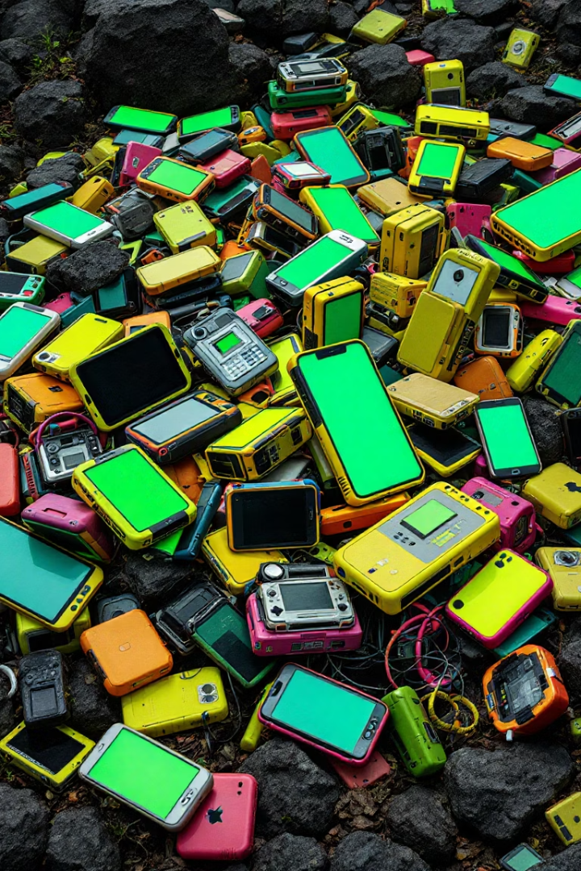
E-Waste Link
(From gadgets to garbage: India’s e-waste puzzle)
This problem is part of a global issue that needs urgent attention. With the rise of technology, the amount of electronic waste is also increasing rapidly. Sustainable practices and proper e-waste management are crucial to protect the environment and human health.

Slide 2

Introduction to E-Waste
What is E-Waste?
Global Volume
Discarded electrical or electronic devices at end of life.
53.6 million metric tons generated in 2019; growing rapidly.
Market Size In India
1)India is now third largest e-waste generator in the world producing an estimated 2.32 million tonnes annually.
2)It is expected to exceed 5 million tonnes by 2030.
3)India recycles only 20–25% of its e-waste formally — the rest is handled by the informal sector

Slide 3

Why E-Waste is a Concern: Toxic Components
Predominance of Informal Sector: Over 95% of India's e-waste is processed by informal workers using rudimentary methods like open burning and acid baths, leading to significant environmental pollution. ​
Health Hazards: Exposure to toxic substances such as lead, mercury, and cadmium during informal recycling processes can cause severe health issues, including neurological damage, respiratory problems, and cancer. ​
Vulnerable Populations at Risk: Children and marginalized communities involved in informal e-waste recycling are particularly susceptible to health risks due to lack of protective equipment and awareness.

Slide 4
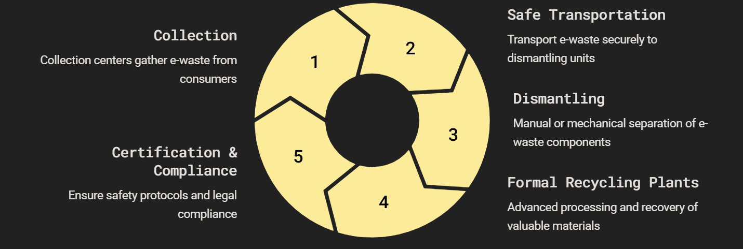
Recycling Infrastructure:

Slide 5
Public Awareness and Campaigns for E-Waste Management:
Why It Matters
Most people are unaware of safe e-waste disposal methods
Limited knowledge about nearby collection points and take-back options
Common myths around recycling value and processes
Effective Awareness Approaches
Education Initiatives: Introduce e-waste topics in schools, colleges, and local communities
Media Outreach: Use TV, radio, and social media to highlight e-waste dangers and solutions
Community Drives: Organize drop-off events with incentives to boost participation
Training Sessions: Educate housing societies, city staff, and informal workers
Success Stories
Swachh Bharat Abhiyan integrating e-waste messaging
Brand partnerships for collection (e.g., Apple, Samsung)
Local NGO awareness efforts in cities like Pune and Bengaluru
Suggested Actions
Mandate awareness spending as part of corporate EPR obligations
Add e-waste awareness to school curriculam
Empower community leaders to promote responsible recycling

Slide 6
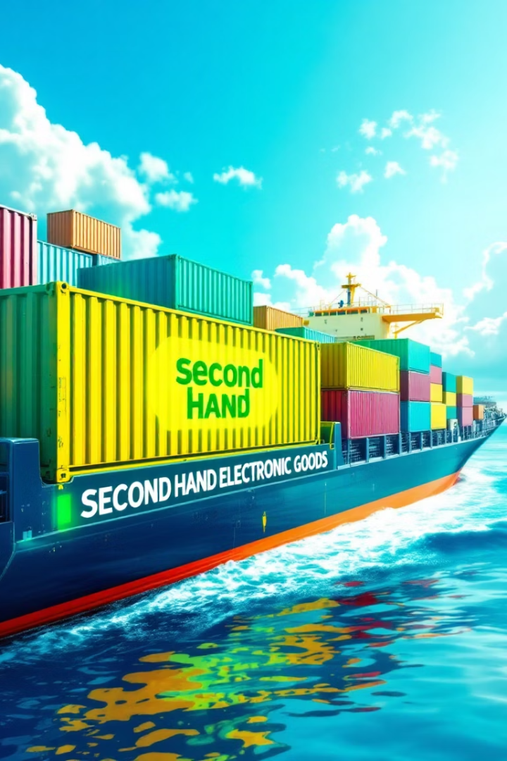
Collection Practices
95% of e-waste is collected by the informal sector
Formal collection points exist but are limited to major urban areas
Public awareness remains low, especially in rural regions
Extended Producer Responsibility (EPR) programs are growing but uneven
Recycling Practices (Today’s Scenario)
Only around 10-15% of e-waste is processed by authorized recyclers
Informal recycling methods involve unsafe manual dismantling, burning, and acid treatment
Valuable materials (gold, copper, etc.) are often lost or recovered unsafely
Key Challenges
Gaps in EPR enforcement and tracking
Weak coordination between producers, recyclers, and local authorities
Lack of accessible infrastructure for safe collection and disposal

Slide 7
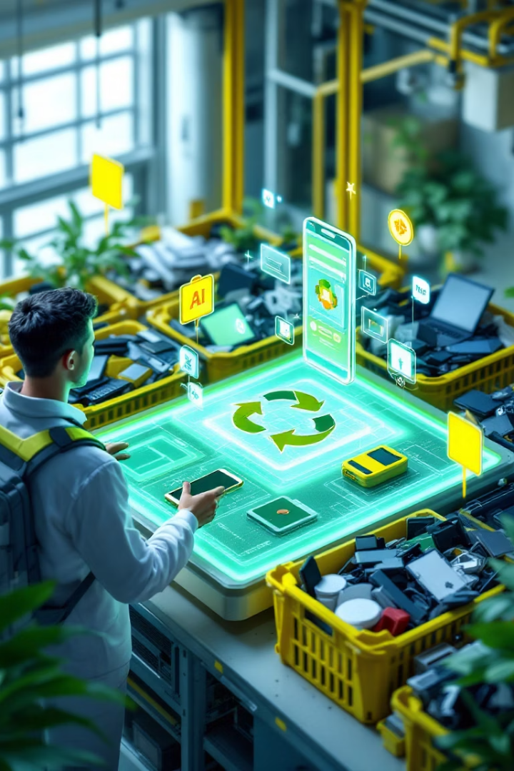
Tech-Driven Platform for Smart E-Waste Management
Objective
Bridge the gap between consumers, informal collectors, and certified recyclers using technology
Core Features
Mobile App (Android/iOS): Allows users to schedule pickups, scan or photograph devices, and get instant quotes
QR Code / IoT Tagging: Each device or batch is tagged at pickup for tracking
AI Vision Engine: Identifies device type/condition and estimates value using image recognition (similar to Karo Sambhav's Azure model)
Blockchain Ledger: Every transaction is securely recorded and immutable
GPS Stamping: Location-verified tracking from collection to recycling
Benefits
Full traceability for regulators, producers, and consumers
Streamlined sorting, valuation, and logistics
Supports all e-waste streams: phones, laptops, EV batteries, solar panels, etc.
Enhances compliance with EPR and recycling regulations

Slide 8
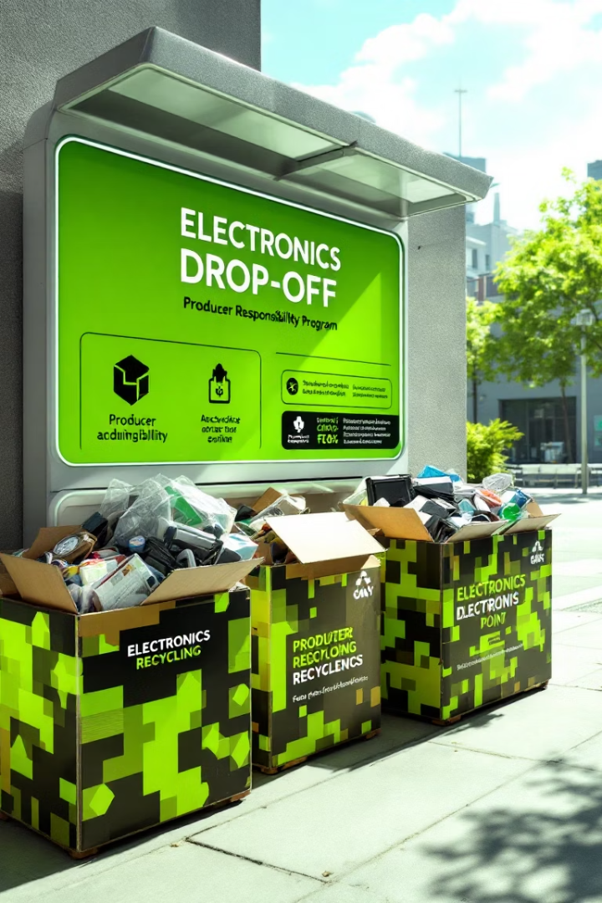
What Makes This E-Waste Solution Unique?
1. End-to-End Traceability
Blockchain-based tracking system ensures every item is logged from pickup to recycling
Enhances transparency and accountability for all stakeholders
2. Integration of Multiple Technologies
Combines Mobile App, IoT tags, AI vision, and Blockchain
Seamless user experience for households, collectors, and recyclers
3. Inclusive of Informal Sector
Formalizes and empowers informal workers with tools, training, and digital access
Bridges the gap between unregulated and certified practices
4. Multi-Stream Compatibility
Supports all e-waste types: phones, laptops, TVs, EV batteries, solar panels, etc.
Centralized solution adaptable for future waste categories
5. Real-Time Valuation and Quotes
AI instantly estimates device value based on image recognition
Ensures fair pricing and quicker processing

Slide 9

Technology Stack For E-Waste Platform:
1. Mobile Application (Android/iOS)
User interface for households and informal collectors
Schedule pickups, scan devices, receive quotes
Real-time notifications and history tracking
2. IoT and QR Code Tagging
Tag each item or batch at the point of collection
Enable device-level identification and batch tracking
3. AI Vision Engine
Uses image recognition to identify device type and condition
Automatically estimates market value
Streamlines sorting and categorization
4. Blockchain Integration
Secure, tamper-proof logging of every transaction
Ensures full traceability from pickup to certified recycling
Builds trust among consumers, recyclers, and regulators
5. GPS Tracking
Location tagging at each stage: collection, transfer, recycling
Prevents illegal dumping or loss of material
6. Data Analytics Dashboard
Aggregated data for regulators and producers
Insights into volume, types, compliance, and recovery

Slide 10
Scalability and Monetization Model for the E-Waste Platform
Modular design supports rollout across cities, rural areas, and states
Cloud-based architecture enables easy expansion and updates
Compatible with multiple e-waste categories: phones, appliances, batteries, etc.
Multilingual app interface increases inclusivity and reach
2. User Growth Channels
Partnerships with municipalities, NGOs, and electronics retailers
Incentives for users and collectors to onboard and engage
Integration with school and workplace collection programs
3. Monetization Streams
Commission on Transactions: Fee on each verified pickup and resale to recyclers
Premium Services for Producers: Compliance dashboards, data analytics, and audit support
Advertising and CSR Sponsorships: From electronics brands and green tech firms
Recyclable Material Sales: Cut of material resale profits via verified recycler network
4. Financial Sustainability
Platform designed for break-even through scale and automation
Opportunities for government and CSR funding support during early stages

